Slide 1
PROTEOME-WIDE SCREEN FOR RNA-DEPENDENT PROTEINS non-synchronized A549 cells datascience SS22, project 3 group 4
Greta Karathanos, Khalida Dushimova, Madleen Piegsa, Richard Langi

Slide 2
The concept of R-DeeP: Proteome-wide Screen for RNA-dependent Proteins
RNA-binding proteins (RBPs)
—> RNA processing and modification (Alternative splicing, RNA editing, polyadenylation), export, mRNA localization, translation
—> disfunction of RBPs: influence on embryonic development and cancer
R-Deep? → based on cellular lysate fractionation by density gradient ultracentrifugation and subsequent analysis by proteome-wide mass spectrometry or individual western blotting
But how? → adaption of the concept of RNA dependence, defining a protein as RNA dependent when its interactome depends on RNA
What to expect? → position in a sucrose density gradient of RDP differs depending on presence of RNA
Our dataset? → non-synchronized A549 cells: Lung carcinoma cells (Caucasian male)
Notes:
Dies ist die Frage, auf die Ihr Experiment die Antwort gibt

Slide 3
Our dataset
Mass spectrometry data from non-synchronized A549 cells
non-synchronized A549 cells? → Lung carcinoma cells (Caucasian male)
Structure of the data? → amount of each protein (3680 human proteins, one protein per row) per fraction (2 samples x 25 fractions x 3 replicates = 150 columns)
Human protein | Fraction 1 Rep.1 Ctlr | Fraction 1 Rep.1 RNase | Fraction 1 Rep.2 Ctlr | Fraction 1 Rep.2 RNase | Fraction 1 Rep.3 Ctlr | Fraction 1 Rep.3 RNase
SPB6_HUMAN | x | x | x | x | x | x
CRYAB_HUMAN | x | x | x | x | x | x
VIGLN_HUMAN | x | x | x | x | x | x

Slide 4
Project Goals/ Milestones
Restructuring, normalization and datacleanup
Our aim? → automatically identify RNA-dependent proteins by analyzing our masspectometry data
Identification of peaks
Shift detection/
k-means clustering
Definition and application of selection criteria
Further analysis and report
Notes:
Fassen Sie Ihre Forschung in drei bis fünf Punkten zusammen.

Slide 5
Milestone 1: Restructuring the data
Ctrl group
Fractions | SPB6_HUMAN_REP_1 | SPB6_HUMAN_REP_2 | SPB6_HUMAN_REP_3 | CRYAB_HUMAN_REP_1 | CRYAB_HUMAN_REP_2 | CRYAB_HUMAN_REP_2
Fraction_1 | x | x | x | x | x | x
Fraction_2 | x | x | x | x | x | x
Fraction_3 | x | x | x | x | x | x
Rnase group
Fractions | SPB6_HUMAN_REP_1 | SPB6_HUMAN_REP_2 | SPB6_HUMAN_REP_3 | CRYAB_HUMAN_REP_1 | CRYAB_HUMAN_REP_2 | CRYAB_HUMAN_REP_2
Fraction_1 | x | x | x | x | x | x
Fraction_2 | x | x | x | x | x | x
Fraction_3 | x | x | x | x | x | x

Slide 6
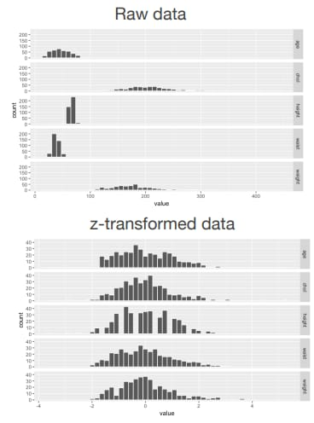
Milestone 1: Normalization
Why?
→ total amount (protein) of every repetions should be
similar
→ change values of numeric columns in our dataset to
a common scale

Slide 7
Milestone 1: Normalization
How to?
→ standarize several variables using the scale function and Z-transformation
→ apply to control and Rnase table
→ compare both methods
Outcome?
→ 2 dataframes (df) (3*3680 x 25) one for the control and one for the RNase group

Slide 8
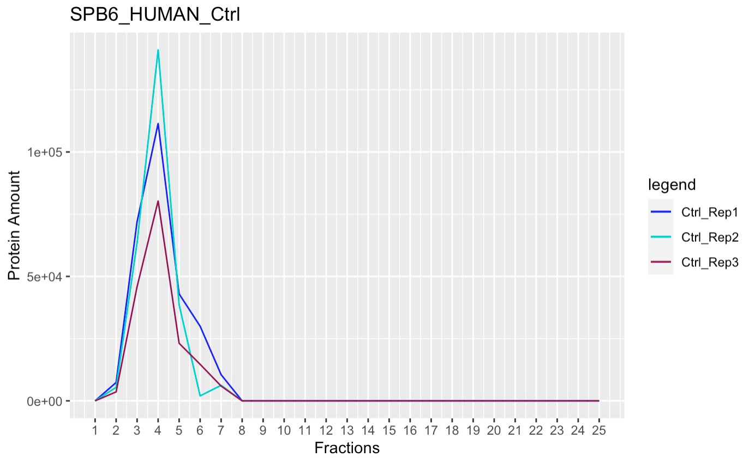
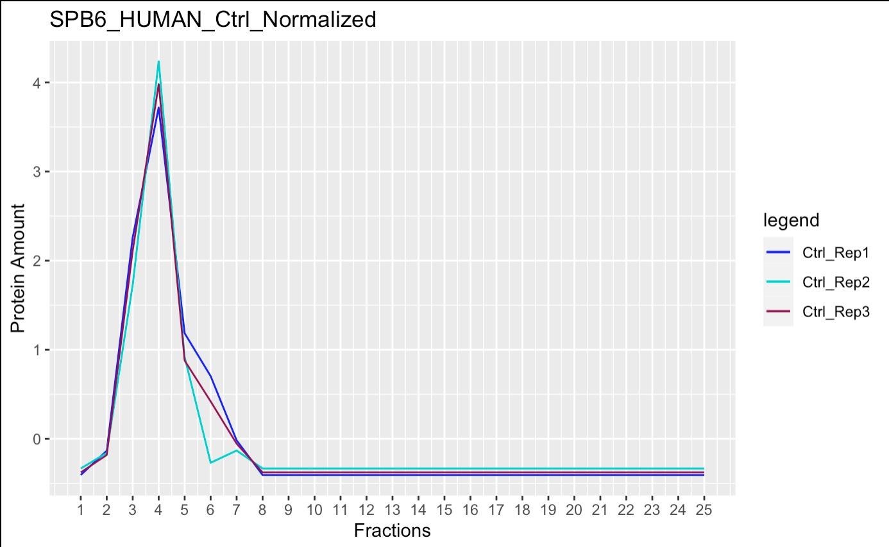
Milestone 1: Normalization (Ctrl group)
Before
After

Slide 9
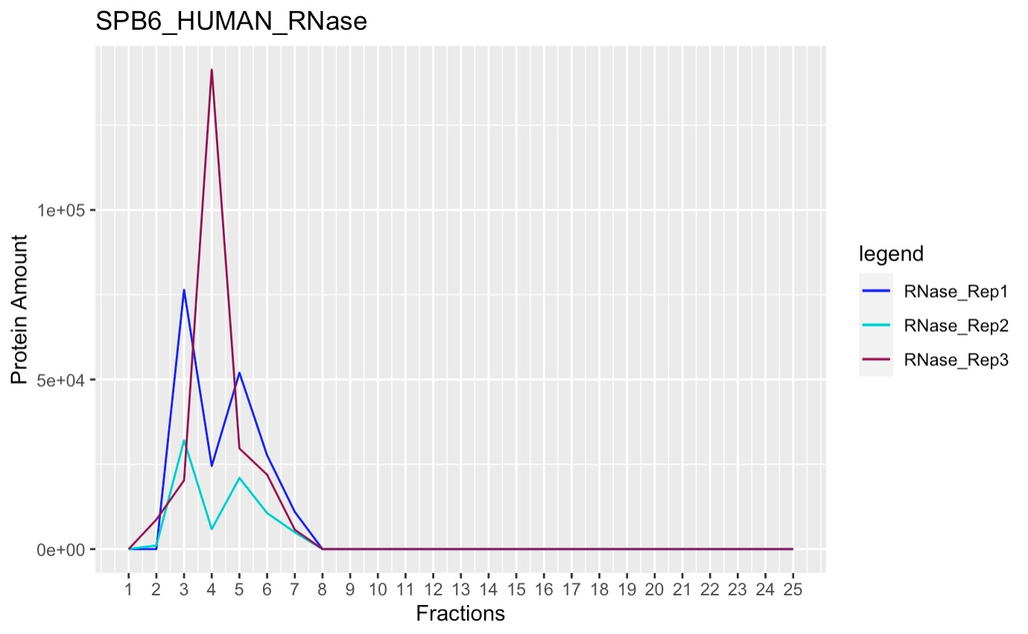
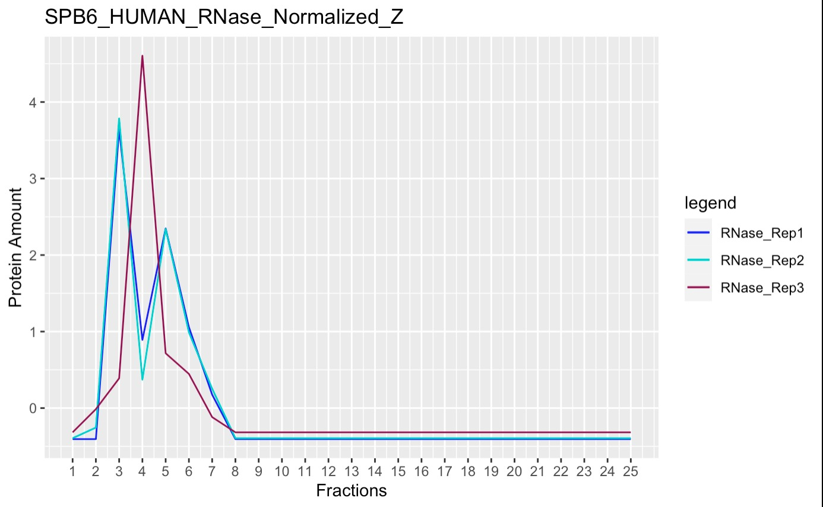
Milestone 1: Normalization (RNAse group)
Before
After

Slide 10
Milestone 2: Identification of peaks
How to?
→ create function that detects maxima automatically
→ compare the results of the self-written function with the existing function
→ adjust self-written function → maxima precisely determinable
Outcome?
→ own maxima detection function
→ 6 df with number and location of the maxima for each protein

Slide 11
Milestone 3: Shift detection/ k-means clustering
How to?
→ figure out difference of the maxima (Ctrl group vs. Rnase group)
→ K-means clustering for assigning each protein into clusters with regard to their
shift characteristics and assign biological meaning to it
Outcome?
→ 2 df (one df per cleaning method)
→ 2 clusters ( RNA-dependent and RNA-independent cluster)

Slide 12
Milestone 4: Definition and application of selection criteria
How to?
→ Define selection criteria ( evaluating the relationship between shift characteristics
and RBPs)
→ apply selection criteria to our 2 df (statistical test, t-test?)
→ determine which human proteins are RBP with insights of milestone 3
→ visualize proteins
Outcome?
→ in ideal case: proteins that are RBPs
→ method to identify them automatically

Slide 13
Milestone 5: Further analysis and report
How to?
→ get comparable information about RBPs ( Uniprot, R-Deep, RBP2GO)
→ look at some example proteins and compare information with information from
given databases
→ highlight outstanding RBPs
Outcome?
→ outstanding RBPs
→ confirmed RBPs
→ RNA- independent proteins

